Slide 1
Empower – Menopause and Cancer Survivorship Pathway
Menopause and Cancer: What to Expect & Symptom Management
Dr Deirdre Lundy, Clinical Lead NMH, Holles Street Complex Menopause Service
Updated Jan 2026

Slide 2
Why is it important to know about Menopause Symptoms and Cancer?
Some cancer therapies can affect the ability of the ovaries to produce eggs and hormones-Cancer therapies might impair fertility & cause menopause-like symptoms
Some patients are already suffering from (peri)menopausal symptoms before they start their
cancer therapies
Chemotherapy and pelvic radiotherapy can result in a range of damage to the ovaries
Targeted anti hormone therapies like Zoladex and Tamoxifen and Aromatase Inhibitors work
by impeding the amounts or actions of Estrogen in the body.
How you might feel on (or after) these therapies (as a result of estrogen fluctuations and/ or loss) may be more problematic for some than others- but everyone should be aware of what might happen before they start their treatment

Slide 3
“Iatrogenic Menopause”
Evidence suggests that menopause caused by medical therapies may be more severe and long lasting than physiological menopause. Following a cancer diagnosis, women may be at an increased risk of affective disorders such as depression and anxiety and menopausal symptoms may exacerbate this risk¹
Younger age at menopause may also be associated with psychological and sexual dysfunction as well as long term risks such as cardiovascular disease, osteoporosis and potentially cognitive dysfunction and dementia²
Notes:
1. Donohoe F, O'Meara Y, Roberts A, Comerford L, Kelly CM, Walshe JM, Lundy D, Hickey M, Brennan DJ. Using menopausal hormone therapy after a cancer diagnosis in Ireland. Ir J Med Sci. 2023 Feb;192(1):45-55. doi: 10.1007/s1
2. Faubion SS, Kuhle CL, Shuster LT, Rocca WA. Long-term health consequences of premature or early menopause and considerations for management. Climacteric. 2015;18(4):483-91. doi: 10.3109/13697137.2015.1020484. Epub 2015 Apr 7. PMID: 25845383; PMCID: PMC4581591.1845-022-02947-6. Epub 2022 Feb 9. PMID: 35141870; PMCID: PMC9892117.

Slide 4
Common Physical Symptoms of
Perimenopause* & Menopause
Night sweat and hot flushes
Menstrual Changes: heavier periods/ irregular periods
Loss of Vaginal Elasticity & Lubrication
Decrease in metabolism resulting in increase in weight
Increase risk of metabolic syndrome
Hair & skin changes
Joint complaints
Bladder complaints/ genito urinary symdrome
Notes:
* Perimenopause is the time before the final menstrual period when people may experience menopausal symptoms but still be having some kind of menstrual cycle activity

Slide 5
Common Psychological symptoms of
Perimenopause & Menopause
Depression,
Mood swings
Anxiety
Tiredness
Memory loss
Concentration loss
Loss of libido
PMS-type symptoms

Slide 6
So… what can be done ?
Menopause hormone therapies (estrogen and progestagen and testosterone) aka MHT or HRT has become widely popular for the management of symptoms but
HRT is not the only way to control menopause symptoms
But what if you have been diagnosed with a Cancer?
How might that affect your choices in managing menopausal symptoms?
What are the recommendations from the experts?
Who can you turn to for ACCURATE information here in Ireland ?

Slide 7
Firstly; what type of cancer have you been diagnosed with ?
Your options and the safety of HRT use will generally vary depending on the
Cancer type with which you have been diagnosed
There are particular concerns about HRT use with Sex Hormone Sensitive cancers
but
As HRT is only lately been popularised & widely used, there will be very few studies looking directly at the pro’s and con’s of HRT use for (peri)menopause in people diagnosed with and treated for any malignancies

Slide 8
Common Cancers in Irish Females
Skin (non melanoma)
Breast
Colorectal
Lung
Melanoma Skin Cancer
Uterine Lining & Body
Ovary
Cervix
Non Hodgkin's Lymphoma
Stomach
Kidney
Mouth, Pharynx, Oesophagus
Leukaemias
Pancreas
Brain
Thyroid
Hodgkin's Lymphoma

Slide 9
How is Guidance on HRT after cancer developed ? What do we know to be true?
How do we know anything to be true in medicine ? Often we start with a question or hypothesis and start to gather data… but
Data is not proof
Data needs to be formulated, gathered, stored, analysed and interpreted before it can be converted into medical knowledge…
…and this can take decades !

Slide 10
So, what are the facts about Using HRT after Cancer ?
No easy answers
No quick fixes
No guarantees

Slide 11
Common Cancers known to be Sex Hormone-linked
Breast
Ovary
Womb lining

Slide 12
Consequences of Breast Cancer Treatments & Menopause symptoms
Surgery: Oophorectomy will lead to immediate Menopause but even hysterectomy with ovary sparing is linked to early menopause symptoms – this seems to be rarely mentioned to patients prior to hysterectomy
Chemotherapy: any chemotherapy regimen can potentially lead to medical menopause but esp cyclophosphamide (Cytoxan)- and also when part of the CMF regime: cyclophosphamide, methotrexate, and fluorouracil. It may be temporary, but more likely to be permanent in older women
Ovarian shut down with Zoladex will also cause immediate Meno symptoms
Radiotherapy: modern targeted treatments is not usually linked to Meno symptoms
Adjuvant Hormonal Therapy: Tamoxifen may cause meno symptoms as can
Aromatase Inhibitors; to a variable degree
Targeted Therapy: Trastuzumab can cause many side effects including flushes

Slide 13
Adjuvant Therapies- AI’s & Tamoxifen
Adjuvant therapy medications eradicate dormant occult micro-metastases that may be in the lymph/ blood/ bone
AI’s stop other sex hormone in the blood from converting into oestrogen- they reduce
estrogen creation in fat & are often given to people at medium to high risk of recurrence
Tamoxifen blocks estrogen receptors – it is effective in both pre- and postmenopausal patients & has estrogen receptor antagonist activity in the breast.
Oncologists report the use of these drugs has been the most significant contributor to the
improvements in breast cancer survival*
But both can cause lots of menopause symptoms esp muscle and joint pain and they impact the vagina in a variety of unpleasant ways so DISCONTINUATION of adjuvant therapy is very common
And… Tamoxifen use in post menopausal patients is liked to a small increased risk of
endometrial cancer** – these drugs are useful but also problematic
Notes:
* Storme GA. Breast Cancer: Impact of New Treatments? Cancers (Basel). 2023 Apr 8;15(8):2205. doi: 10.3390/cancers15082205. Erratum in: Cancers (Basel). 2023 Sep 12;15(18):4514. doi: 10.3390/cancers15184514. PMID: 37190134; PMCID: PMC10136973.
** Pleasant V, Pearlman MD. Does tamoxifen use increase the risk of endometrial cancer in premenopausal patients? OBG Manag. 2023 Aug;35(8):17-21. doi: 10.12788/obgm.0297. PMID: 38919701; PMCID: PMC11197877.

Slide 14
How it should be done….
In the UK, they recommend a written care plan should be developed at the end of active treatment (surgery, chemotherapy, Trastuzumab and radiotherapy)
This care plan should be agreed with a NAMED doctor or nurse in the Breast Clinic and a GP
It should include dates for review of adjuvant endocrine therapy for women with ER+ve cancer, details of mammograms and information about signs and symptoms of recurrence, or treatment side effects, with contact details for immediate referral to specialist care or support services.
That information should include a pathway for women experiencing estrogen deficiency symptoms arising from a natural or chemotherapy induced menopause, or to tamoxifen or aromatase inhibitor exposure*
Notes:
* www.nice.org.uk/guidance/ng101

Slide 15
What about using HRT after a Breast Cancer Diagnosis ?
There have been no large-scale, reliable studies where people with different types of breast cancer were enrolled according to their cancer type and then offered different types of HRT vs Placebo
The belief in medical circles is that a such study would never get approval
In the absence of good clinical data, it is unlikely we will ever have a definitive guideline to advise on HRT use after breast cancer
It is generally not recommended to use systemic oestrogen or progestagen
in someone with a diagnosis of breast cancer

Slide 16
Using HRT after a Breast Cancer Diagnosis cntd.
The British Menopause Society (BMS) advises that a history of breast cancer should be considered a contraindication to systemic HRT. ‘Non-hormonal options should be the first-line treatment in women with a history of breast cancer, particularly those receiving tamoxifen or aromatase inhibitors’ is the current BMS advice*
They say ‘people who have been diagnosed with breast cancer who experience ongoing menopausal symptoms but who have failed to respond to non-hormonal management should be referred to discuss their options with a menopause specialist and oncology team.’
An individualised plan based on the patient’s individual circumstances should be
discussed.
Notes:
*thebms.org.uk/publications/consensus-statements/risks-and-benefits-of-hrt-before-and-after-a-breast-cancer-diagnosis/

Slide 17
What about local vaginal estrogen after a breast cancer diagnosis?
Neither systemic HRT nor low dose, local vaginal oestrogen are recommended in women taking an aromatase inhibitor and with both, prescription should only take place after discussion between the patient, her primary health care and breast specialist team. We are often given a green light for LVE by one oncology service while some other service might recommend against
Local vaginal estrogen use IS supported by most oncologists for people with vaginal/ pelvic symptoms who are using tamoxifen if other, non – hormonal remedies have been unhelpful. Guidelines in both menopause and oncology support the use of LVE in people NOT USING AI’s
We have very limited studies to confirm that using local vaginal estrogen does not undermine the impact of AI’s so we need to discuss this when prescribing
Notes:
thebms.org.uk/publications/consensus-statements/risks-and-benefits-of-hrt-before-and-after-a-breast-cancer-diagnosis/

Slide 18
What about ER-/PR- Breast Cancer?
Iatrogenic menopause symptoms are not limited to women with hormone sensitive disease as chemotherapy-induced ovarian suppression will occur irrespective of the oestrogen receptor (ER) status of the primary tumour¹
HRT may not be without risk for those with an ER negative primary.
Although there is high concordance in hormone receptor status between first and second primary breast cancers, a minority with an ER negative primary may present with an ER positive contralateral cancer (up to 30%)² and approximately 8% may present with ER positive metastatic disease.³
There is generally less concern about systemic absorption from low and ultra-low dose vaginal oestrogen, which is minimal and could be acceptable where systemic therapy would not be.
Notes:
Yordanov A, Hasan I, Vasileva-Slaveva M, Tsoneva E, Kostov S, Yanachkova V. Surgical Ovarian Suppression and Breast Cancer-What Do We Know About It? Medicina (Kaunas). 2025 Oct 24;61(11):1905. doi: 10.3390/medicina61111905. PMID: 41303742; PMCID: PMC12654572.
Sandra M. Swain, et al Estrogen Receptor Status of Primary Breast Cancer Is Predictive of Estrogen Receptor Status of Contralateral Breast Cancer, JNCI: Journal of the National Cancer Institute, Volume 96, Issue 7, 7 April 2004, Pages 516–523, https://doi.org/10.1093/jnci/djh097
Zhao J, Hu C, Wang C, Yu W, Guo Y, Shi M, Shui Y, Wei Q. Breast cancer primary tumor ER expression pattern predicts its expression concordance in matched synchronous lymph node metastases. BMC Cancer. 2018 Dec 27;18(1):1290. doi: 10.1186/s12885-018-5217-5. PMID: 30587150; PMCID: PMC6307150.

Slide 19
What about HRT with BRCA mutations?
Carrying a BRCA gene mutation affects your risk of cancer developing. Having a BRCA mutation does not bring on an earlier or more severe menopause experience, but it might make some people / medics hesitant about offering HRT if needed
Risk reducing surgeries such as having your ovaries & tubes removed will obviously throw the patient into surgical menopause and while lifestyle and non-hormonal alternatives should be used as first-line management of vasomotor symptoms in women at very high risk of breast cancer (who are experiencing typical meno sx at the usual age)
‘HRT may be needed for severe, refractory symptoms and should be considered on an individual basis following specialist and patient discussion.’
Notes:
1. thebms.org.uk/publications/consensus-statements/risks-and-benefits-of-hrt-before-and-after-a-breast-cancer-diagnosis/
2. Kotsopoulos J, Gronwald J, Karlan BY, et al. Hormone Replacement Therapy After Oophorectomy and Breast Cancer Risk Among BRCA1 Mutation Carriers. JAMA Oncol. 2018;4(8):1059–1065. doi:10.1001/jamaoncol.2018.0211
3. Huber D, Seitz S, Kast K, Emons G, Ortmann O. Hormone replacement therapy in BRCA mutation carriers and risk of ovarian, endometrial, and breast cancer: a systematic review. J Cancer Res Clin Oncol. 2021 Jul;147(7):2035-2045. doi: 10.1007/s00432-021-03629-z. Epub 2021 Apr 22. PMID: 33885953; PMCID: PMC8164576.
& Chlebowski RT, Anderson GL, Aragaki AK et al. Association of menopausal hormone replacement therapy with breast cancer incidence and mortality during long-term
follow-up of the Women’s Health Initiative randomised clinical trials. JAMA, 2020; 324: 369-380.

Slide 20
But it is a different story after Risk Reducing Surgery!
The exception to this is BRCA1 and BRCA2 mutation carriers who have undergone risk reducing
bilateral salpingo-oophorectomy (BSO).
Here, add-back HRT has not been shown to diminish the risk-reducing benefit of BSO on subsequent risk of breast cancer diagnosis (but clinical data is very limited)
Further studies are needed to clarify risk with combined compared with unopposed HRT and the
optimal duration of use.
The current recommendation is that after risk-reducing BSO, add-back HRT is used until the age of an expected natural menopause (50/51), after which non-hormonal alternatives are used as first-line management for symptom control and the prevention of chronic, oestrogen-deficiency health problems.
Notes:
Huber D, Seitz S, Kast K, Emons G, Ortmann O. Hormone replacement therapy in BRCA mutation carriers and risk of ovarian, endometrial, and breast cancer: a systematic review. J Cancer Res Clin Oncol. 2021 Jul;147(7):2035-2045. doi: 10.1007/s00432-021-03629-z. Epub 2021 Apr 22. PMID: 33885953; PMCID: PMC8164576.

Slide 21
BMS is cautious but open
The British Menopause Society is guarded in its recommendations but emphasise individualisation of care. Their detailed guideline on managing menopause symptoms after a diagnosis of breast cancer includes:
Patients should be referred to a HCP with expertise in gynaecological endocrinology for counselling about the possible consequences of their breast cancer treatment BEFORE THE TREATMENT STARTS
Ideally, people diagnosed and treated for breast cancer should be encouraged to try non-HRT strategies but if these are ineffective,
Systemic hormone replacement therapy or low-dose topical oestrogen may be considered, but only after taking specialist advice
Switching breast cancer hormone treatments or taking a break from them might also be suitable, but this needs to be discussed with the oncologist
Notes:
thebms.org.uk/publications/consensus-statements/risks-and-benefits-of-hrt-before-and-after-a-breast-cancer-diagnosis/

Slide 22
Ovarian Cancer- are not all the same
Ovarian cancer is the fourth most commonly diagnosed cancer in females in Ireland with approx. 400 new
diagnoses each year¹
Use of HRT for > 5 yrs. risk may increase the risk of being diagnosed with ovarian cancer (WHI data)
There is no effective screening strategy for ovarian cancer. Investigation of symptoms includes TV USS, MRI and se CA125 measurement but these are not to be used as screening tools²
Prevention- the only intervention proven to significantly reduce mortality due to ovarian cancer in women at high inherited risk of OC is risk-reducing bilateral salpingo- oophorectomy (RRBSO) - the possible outcomes of this surgery should be discussed with patients prior to surgery. While not inevitable, it is not uncommon for patients to develop menopause symptoms after RRBSO- and may be at risk of premature/ early meno consequences
Notes:
1 www.cancer.ie/cancer-information/cancer-types/ovarian-cancer
2. www.mayoclinic.org/diseases-conditions/ovarian-cancer/diagnosis-treatment/

Slide 23
Guidance on HRT will vary with ovarian cancer subtype
For High grade Serous OC (75% of diagnoses), the available research suggests that it is reasonable to consider MHT.
For Mucinous OC, which is not a hormone sensitive cancer, it is safe to consider MHT.
For Clear cell OC, MHT may be considered but as this OC is linked to VTE, judicious choice of HRT dose, molecule and
delivery is advised.
For Germ cell OC, MHT can be offered if required.
For Borderline OC (Slow growing, slow to spread, generally diagnosed at an early stage & usually cured by surgery). MHT can be offered if required.
For Endometrioid OC; one of the more common OC’s diagnosed in younger females, use of MHT appears safe but data is sparse
For Low Grade Serous OC, which is highly hormonally driven and often managed by oestrogen blockers, use of MHT is not recommended.
For Sex Cord Stromal tumours e.g. granulosa cell tumours, as these are usually hormone sensitive, use of MHT is not recommended.
Notes:
This info comes from a joint guideline published in 2024 by the British Menopause Society in partnership with the British Gynaecological Cancer Society called ‘the Management of menopausal symptoms following treatment of gynaecological cancer’ See thebms.org.uk/publications/bms-guidelines/management-of-menopausal-symptoms-following-treatment-of-gynaecological-cancer/
Remember – some of these recommendations are based on very old / poor studies so discussion with the oncology team is advised

Slide 24
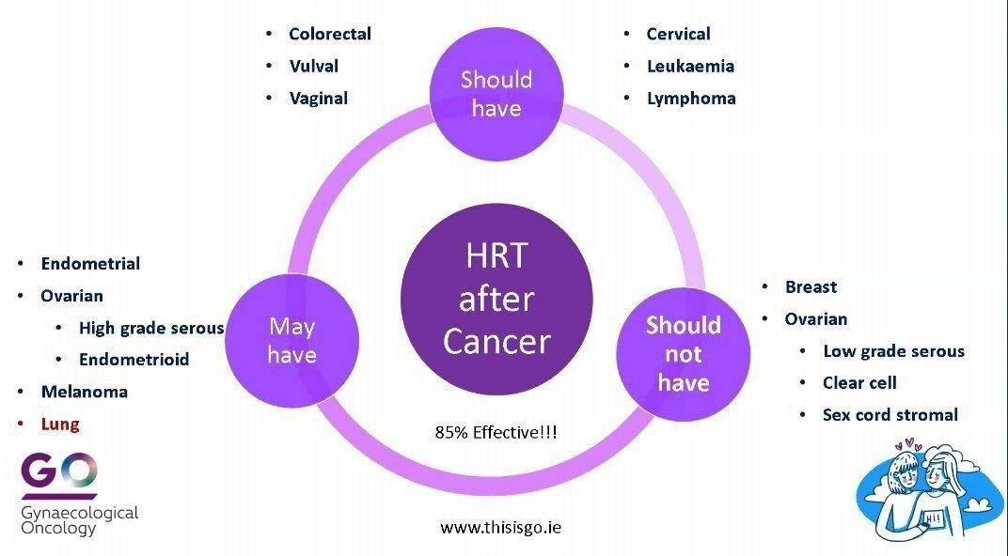
Notes:
These recommendations from thisisgo.ie are also quite broad and discussion with individual oncology experts is advised
See www.thisisgo.ie

Slide 25
Endometrial Cancer*
Currently, there is insufficient high-quality evidence to inform women considering HRT after treatment for endometrial cancer. The available evidence (both the single RCT and non-randomised evidence) does not suggest significant harm, if HRT is used after surgical treatment for early-stage endometrial cancer.
Limited, very-low certainty, evidence suggests that HRT may have little or no effect on the risk of endometrial cancer returning for women who have been treated surgically for an early-stage endometrial cancer or their survival rates
There is no information available regarding use of HRT in higher-stage endometrial cancer
(FIGO stage II and above).
The use of HRT after endometrial cancer treatment should be individualised, taking account of the woman's symptoms and preferences, and the uncertainty of evidence for and against HRT use.
*not the rare ‘endometrial sarcomas’ which ARE estrogen sensitive & can be highly malignant ³
Notes:
This info comes from a joint guideline published in 2024 by the British Menopause Society in partnership with the British Gynaecological Cancer Society called ‘the Management of menopausal symptoms following treatment of gynaecological cancer’ See thebms.org.uk/publications/bms-guidelines/management-of-menopausal-symptoms-following-treatment-of-gynaecological-cancer/

Slide 26
Vaginal and vulval cancer
Since most vaginal/vulval cancers are squamous cell carcinomas, there is no evidence of recurrence of vulval disease with hormone use
HRT is not contraindicated.
Systemic and local vaginal oestrogen HRT can be offered after treatment for vaginal and vulval carcinoma.
Notes:
thebms.org.uk/publications/bms-guidelines/management-of-menopausal-symptoms-following-treatment-of-gynaecological-cancer/

Slide 27
Cervical Cancer
HRT is not contraindicated after treatment for squamous cell carcinoma of the cervix or adenocarcinoma of the cervix.
A systematic review of HRT and cervical cancer was published in 2021¹ Several studies linked significantly reduced risk of developing cervical squamous cell carcinoma in postmenopausal women treated with HRT, with a weak increase in the incidence of adenocarcinoma identified. There were no reports of a harmful effect of HRT on cervical cancer treatment outcomes.
Several benefits (reduced metabolic risk, increased QoL) were identified in younger cervical cancer survivors especially.
Notes:
1. Gorman M, Shih K. Updates in Hormone Replacement Therapy for Survivors of Gynecologic Cancers. Curr Treat Options Oncol. 2025 Mar;26(3):179-186. doi: 10.1007/s11864-025-01298-5. Epub 2025 Mar 5. PMID: 40042741; PMCID: PMC11919963.
thebms.org.uk/publications/bms-guidelines/management-of-menopausal-symptoms-following-treatment-of-gynaecological-cancer/

Slide 28
Colorectal cancer
The WHI trial showed that the risk of colorectal cancer was reduced in the combined oestrogen and progestogen arm.
No effect was shown in the oestrogen alone group.
The risk reduction of combined oestrogen and progestogen reduced after stopping HRT over 13 years cumulative follow-up.
Notes:
Simon MS, et al Estrogen plus progestin and colorectal cancer incidence and mortality. J Clin Oncol. 2012 Nov 10;30(32):3983-90. doi: 10.1200/JCO.2012.42.7732. Epub 2012 Sep 24. Erratum in: J Clin Oncol. 2013 Jun 1;31(16):2063. PMID: 23008295; PMCID: PMC3488271.

Slide 29
HRT also considered OK after diagnosis of
cancer of the ….
Lung, Stomach, Kidney, Mouth, Pharynx, Oesophagus, Pancreas, Brain, Thyroid, Skin (non melanoma) & Uterine Body
Hodgkin's & Non-Hodgkin's Lymphomas, Malignant melanomas & Leukaemias
Notes:
www.thisisgo.ie

Slide 30
What can be done about Menopause symptoms without HRT? What actually works ?
Optimising general health & nutrition may help lessen some of the impact of the menopause but will not replace benefits of HRT
Some OTC supplements are advertised for menopausal symptom relief, but few studies show them to be more effective than placebo & they are not tested for safety

Slide 31
Health Promotion: Diet
Oily fish, low GI fruits & veg, whole grains, soya, legumes, etc all reduce LDL cholesterol
Avoiding excess red meat & simple sugars can improve weight and reduce hot sweats
Vitamin D intake of at least 400mIU/day will improve bone health –
supplements will be advised in the winter
Calcium 700-1200mg /day ideally via diet but supplements may be
useful for people with low Ca diets

Slide 32
Health Promotion: Movement
Regular Physical Activity :
Decreases premature death, heart disease, diabetes, high blood pressure, colon cancer, obesity and more
Exercise has a beneficial effect on Bone & Muscle and can reduce the risk of falling by improving strength, flexibility & balance.
Exercise improves most psychological symptoms
Exercise reduces bad cholesterol and raises the good cholesterol

Slide 33
Health Promotion: Weight Gain Management
Menopause can result in weight gain due to:
Metabolic slow down
Shift from Gluteo- femoral to Central adipose deposition Weight gain can trigger:
Tiredness & Low Mood which then promote increased calorie intake
Overweight/Obesity is now thought of as a chronic medical illness as opposed to the result of poor lifestyle choices, new Rx interventions on trend

Slide 34
Health Promotion: Reducing Alcohol
Moderate alcohol intake (<2 units/day) is linked to lower mortality than abstinence – although the link is unclear
Breast Cancer risk however is higher in women who consume even low levels of alcohol (compared to abstinent women)
Heavy alcohol consumption is linked to increased rates of breast cancer, low bone density, falls & fractures and more

Slide 35
Health Promotion: Smoking Cessation {& vaping!)
Not smoking:
improves sleep, hair, skin & teeth quality
improves your exercise capacity, endurance & enjoyment
improves fertility for both men and women
increases your potential life span by 10-15 years
reduces your risk of Heart Disease, Emphysema, Lung Cancer, Throat Cancer, Mouth
Cancer, Bladder Cancer, Breast Cancer, Thrombosis, Stomach Ulcers and more
Stopping smoking:
Reduces your risk of death from heart disease by 50% within 6 months

Slide 36
Complimentary & Herbal Therapies
Phyto Estrogens: have not been proven superior to placebo
Isoflavones as found in Soya, Red Clover & Chick Peas, no evidence of relief
Lignans are found in Bran, Flax, Legumes and may give some benefit
Herbal Remedies (all are probably safe for most women but not yet proven effective & NOT RECOMMNEDED WHILE ON ADJUVANT THERAPY)
e.g. Black Cohosh, Ginseng, EP oil, Dong Quai, Gingko biloba, Sage, Wild Yam &
St John’s Wort
Vaginal interventions: moisturisers, lubricants, vaginal LASER rejuvenation may all have benefit
“Bio Identical Hormones” is a marketing slogan- these products are created in compounding pharmacies that are often unregulated and these products are not recommended for anyone but esp NOT after Breast Cancer

Slide 37
Alternative Therapies: Flushes & Sweats reduce using CBT & Mindfulness
Cognitive Behavioural Therapy has been found beneficial over placebo in several aspects of Peri menopausal management including VMS relief with up to 50% reduction
Access to CBT is not always easy and may be costly
Mindful Meditation Practice is recommended by NICE for help with low mood & anxiety (MENOS 2)
Notes:
Fenlon D, et al Effectiveness of nurse-led group CBT for hot flushes and night sweats in women with breast cancer: Results of the MENOS4 randomised controlled trial. Psychooncology. 2020 Oct;29(10):1514-1523. doi: 10.1002/pon.5432. Epub 2020 Jul 24. PMID: 32458473; PMCID: PMC7590063.
Also
Susanne Bokmand, Henrik Flyger, Acupuncture relieves menopausal discomfort in breast cancer patients: A prospective, double blinded, randomized study, The Breast, Volume 22, Issue 3, 2013, Pages 320-323, ISSN 0960-9776,
Bilc, M., Pollmann, N., Buchholz, A. et al. Yoga and meditation for menopausal symptoms in breast cancer survivors: a qualitative study exploring participants’ experiences. Support Care Cancer 32, 413 (2024).
Elkins GR, et al. Clinical hypnosis in the treatment of postmenopausal hot flashes: a randomized controlled trial. Menopause. 2013 Mar;20(3):291-8. doi: 10.1097/gme.0b013e31826ce3ed. PMID: 23435026; PMCID: PMC3556367.
Franzoi MA, et al Evidence-based approaches for the management of side-effects of adjuvant endocrine therapy in patients with breast cancer

Slide 38
Medications that might help YOUR
Menopause Symptoms
Oxybutynin
An anti cholinergic Over Active Bladder medicine, Oxybutynin has been shown to reduce severity & frequency of flushes/sweats at 2.5 – 5mg 2-3 times a day – Daytime flushes
No license for this as yet but being trialled in Breast Cancer survivors
Using it off label now in CMS, Holles St

Slide 39
SSRI/ SNRI:
One of the more effective pharmacologic alternatives to oestrogen includes the SSRI and SNRI classes. Their efficacy has been demonstrated in placebo- controlled trials and also a meta-analysis of 43 trials of non-oestrogen therapies.
Those with statistically significant reductions in vasomotor symptoms in large, randomised, double blind, placebo-controlled trials of symptomatic women include Paroxetine, Escitalopram, Citalopram, Venlafaxine, and Desvenlafaxine.
Help with low mood in higher doses, bad for libido though
Reduction in hot flashes varies from 25% to 69%, with improvements in hot flash frequency and severity from 27% to 61%. Less consistent results have been seen with Sertraline and Fluoxetine.

Slide 40
Studies demonstrate efficacy with the following doses:
Venlafaxine 37.5mg titrated up to 150mg per day
Paroxetine 10 mg daily or
Citalopram 10mg-30mg
Some SSRIs inhibit cytochrome P450 activity, an enzyme involved in tamoxifen metabolism and consequently most guidelines recommend that SSRIs such as Fluoxetine and Paroxetine must not be prescribed concomitantly with Tamoxifen.
Venlafaxine is the preferred treatment for women who are taking tamoxifen and has been shown to have a significant positive impact on VMS, mood and sleep

Slide 41
Gabapentin
Although frequently used as an anti-epileptic or for relief from neuropathic pain-when given in high does- among other indications, gabapentin has also been shown to reduce vasomotor symptoms by as much as 50% in some women; esp good for night time flushes
It can safely be used in women who are taking Tamoxifen. Due to its sedative effect, it
may also benefit women who are reporting difficulty with sleep.
Gabapentin 100- 900 mg/day (typically administered three times per day) has been shown to be more effective than placebo in a number of trials.
The potential for side effects (headaches, dizziness, drowsiness) may limit its use, particularly in higher doses.
A stepwise increase in dosage by 300 mg per week up to a maximum of 1.2 g is advised to minimise the side-effects.
We use TINY doses in the CMS, Holles ST as it is a drug of addiction and has street value!

Slide 42
Clonidine
Clonidine is an alpha adrenergic receptor agonist and is the only non-hormonal drug with a licensed indication for control of hot flushes. Clonidine 25mcg is prescribed twice daily for two weeks, increased up to a maximum of 50 mcg three times a day.
Studies involving clonidine are small and results are mixed, suggesting a marginal benefit over placebo- which is frustrating for us as it is the only licensed alternative !
Side effects of clonidine are dose-related and at higher doses clonidine may cause sleep disturbance, dry mouth, and postural symptoms. It must be withdrawn gradually as abrupt cessation can cause rebound hypertension.
It is not recommended as a first line treatment in women with no contraindication to HRT.

Slide 43
Neurokinin 3 + 1&3 Receptor Antagonist drugs
One of the main causes of vasomotor flushes and sweats (VMS) appears to be linked to the activity of the KNDy brain cells in the hypothalamus & their relationship to estrogen.
Estrogen is known to suppress the activity of the KNDy neurons that control temperature. When estrogen is lost this suppression is also lifted and temperature can fluctuate.
The new NK 3 receptor antagonist “VEOZA”(Fezolinetant) blocks the NK3 Receptors like Estrogen would have and so reduces VMS^{1,2}, almost as effectively as HRT but we have LIMITED SAFETY DATA IN BREAST CANCER AS YET
The NK3R antagonist fezolinetant (Veoza) has been approved by the FDA and in Europe for menopausal symptoms but they are not yet incorporated into standard oncology guidelines for breast cancer survivors.
It is available in Ireland but costly as it is not yet on the DPS or medical card
Notes:
Gompel A, Stuenkel CA. Neurokinin 3 receptor antagonists for menopausal vasomotor symptoms, an appraisal. Cell Rep Med. 2023 Jun 20;4(6):101076. doi: 10.1016/j.xcrm.2023.101076
Lederman S, Ottery FD, Cano A, et al. Fezolinetant for treatment of moderate-to-severe vasomotor symptoms associated with menopause (SKYLIGHT 1): a phase 3 randomised controlled study. Lancet. 2023;401(10382):1091-1102. doi:10.1016/​s0140-6736(23)00085-5
Neurokinin 3 receptor antagonists for menopausal vasomotor symptoms Julia K Prague The Lancet Volume 401, Issue 10382, 1–7 April 2023, Pages 1055-1058
4. Elinzanetant for Vasomotor Symptoms from Endocrine Therapy for Breast Cancer, Fatima Cardoso, M.D., Susanne Parke, M.D., Donal J. Brennan, M.B., Ph.D., Paula Briggs, M.B., Ch.B., Gilbert Donders, M.D., Nick Panay, F.R.C.O.G., Nazanin Haseli-Mashhadi, M.Sc., et al June 2, 2025, N Engl J Med 2025;393:753-763 DOI: 10.1056/NEJMoa24155

Slide 44
What seems to help/ what can be tolerated?
Flushes & Sweats:
SNRI/ SSRI (may get benefit from v low doses)*
Oxybutynin (Kentara patch or 2.5mg PO going up slowly)
CBT
Sleep
Gabapentin (start slow 100mg nocte and work up to 300mg TID) or Pregabalin (50-300mg daily in div doses)
Mirtazapine 7.5mg nocte
Phenergan 25mg nocte/ Piriton 4mg nocte
Mood
-SNRI/ SSRI: Sertraline best for anxiety*
-CBT
Joint pains
-Yoga/ Acupuncture
-Gabapentin (as above)
GSM
-Moisturisers/ Lubes
-Local Vag E2 or E3 (C/I w AI)
-LASER??
-
*Avoid Paroxetine, Fluoxetine and Sertraline for Tamoxifen users- Venlafaxine, Citalopram or discuss with Oncology

Slide 45
Over the Counter Alternatives:
Phytoestrogens and Herbal remedies
Isoflavones and phytoestrogens (nonsteroidal compounds that occur naturally in many plants, fruits, and vegetables) have not been consistently found to be more efficacious than placebo for vasomotor symptoms. Data from some of the better researched phytoestrogen containing preparations/ supplements appear to demonstrate some benefits, not only for symptom relief, but also on the skeleton and cardiovascular system.
A meta-analysis of soy isoflavones showed a 25% reduction in hot flushes after elimination of the placebo effect.
Data regarding long-term health outcomes such as ischemic heart disease, osteoporosis or endometrial safety are not available.
Phytoestrogens and black cohosh are considered contraindicated in women with a history of an oestrogen-sensitive cancer.
St. John’s Wort can affect the efficacy of warfarin and other conventional medicines.
There is also concern that it could potentially affect the metabolism of Tamoxifen

Slide 46
Acupuncture
Acupuncture is one of the most common complementary therapies for vasomotor symptoms
The evidence for its efficacy is conflicting
Most of the trials have been small and may have methodological flaws
A randomised, sham-controlled (placebo) trial in 327 peri- or postmenopausal women who reported moderate to severe VMS. The patients were randomly assigned to 10 acupuncture (or sham acupuncture) treatments over two months
The reported severity and frequency of vasomotor symptoms after treatment was reduced by equal amounts in both interventions. However, other double-blinded trials have found some benefit of acupuncture over sham-acupuncture
More trials are needed to clarify

Slide 47
Joint and Musculoskeletal symptoms are linked to cancer treatments
Musculoskeletal symptoms associated with the use of aromatase inhibitors is estimated to affect just under one half of treated women- they usually develop within a few months of commencing treatment and they may persist for the duration of use.
Common symptoms include morning stiffness and pain affecting the hands, knees, hips, lower back, and shoulders- these most likely result from estrogen deprivation but inflammatory pathways and a tenosynovitis type effect (fluid retention in joints) may also have a role in the cause

Slide 48
Non-Medical therapies for Joint pains include:
Aerobic exercise and resistance training -improves pain symptoms and muscle
strength
Yoga improves muscle and joint pain (myalgia and arthralgia)
Acupuncture has also been reported to be of benefit in reducing pain too
Weight management

Slide 49
Medical therapies for Joint pains include:
SNRI (Duloxetine), oral testosterone, diuretics and omega-3 fatty acid have all shown some improvement but
Most of these studies are of a short duration (less than 6 months) and further longer-term, controlled evaluation is required to determine efficacy and side-effect profiles.
The use of oral testosterone (i.e. 40mg or 80 mg of testosterone undecanoate) was not associated with any increase in serum estradiol when compared to women allocated placebo)*
Uncontrolled data suggests that Bisphosphonates may reduce aromatase-induced arthralgia, in addition to preventing bone loss.
Switching between aromatase inhibitors (i.e. Letrozole and Anastrozole) and intermittent Letrozole dosing are further areas of current investigation.

Slide 50
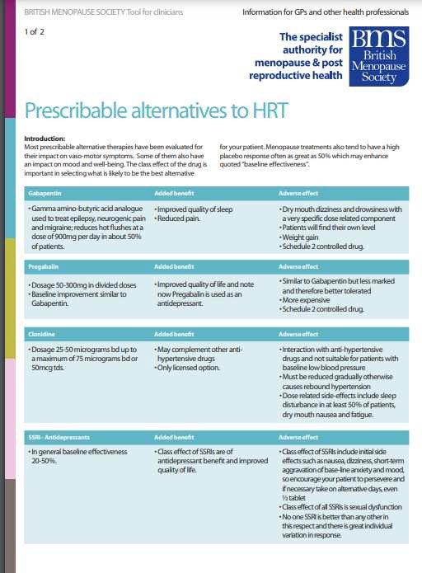

Slide 51
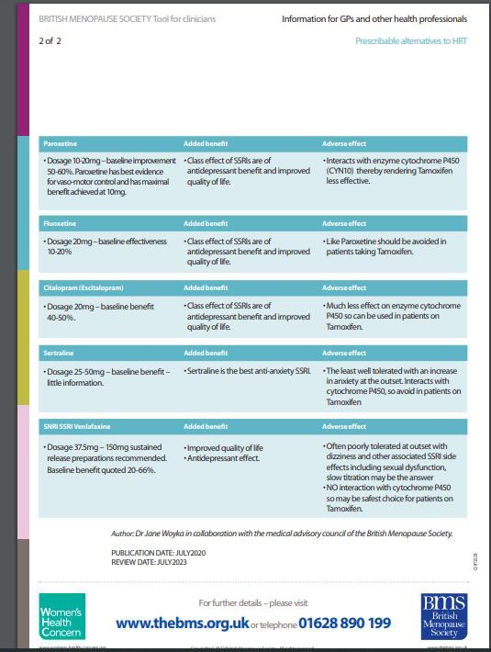

Slide 52
What about Osteoporosis?
Osteoporosis is prevented by HRT- it slows down the bone loss that is a natural consequence of the menopause
Preventing Osteoporosis via HRT is a major additional benefit for menopausal women who use HRT for the treatment of their menopause symptoms or who have had bilateral oophorectomy ( both ovaries removed)
There is no evidence that any other alternative treatment for menopause symptoms are beneficial for osteoporosis prevention but the benefit of HRT on osteoporosis is quickly lost when HRT is stopped so another therapy must be offered
Bisphosphonates may reduce bone recurrence and breast cancer mortality in postmenopausal women with early-stage disease and is offered to postmenopausal women with lymph node involvement (considered in people without nodal involvement but considered at high risk of recurrence) *

Slide 53
New options for flushes on the horizon
‘Fezolinetant’ is the first of the new Selective Neurokinin-3 Receptor Antagonists to come to market
Improvements in hot flush frequency, severity, and quality of life has been shown in US and European clinical trials using NK3R antagonists in postmenopausal women
How do they work?? Well, flushes start in the brain. Nerve cells is the brain (KNDY Neurons) rely on Estrogen to stay balanced in calm.
In the absence of Estrogen, those neurons become hyperactive releasing transmitter chemicals that mess up your body’s ability to regulate temperature. The NK3RA’s BLOCK those neurons and reduce the flushes

Slide 54
GENITO-URINARY SYNDROME of the
MENOPAUSE or “GSM”
Is the new term for vulvo-vaginal atrophy & describes the group of menopausal symptoms and signs including:
Vaginal dryness
Vaginal burning & irritation
Sexual symptoms such as lack of lubrication &
Dyspareunia (painful sex) &
Urinary symptoms such as:
Urgency, Frequency, Dysuria & recurrent Urinary tract Infections

Slide 55
GSM is a consequence of Estrogen deficiency:
Loss of Estrogen causes a reduction in the number and quality of blood vessels in the pelvis
is reduced) & Thinning of both muscles and vaginal lining epithelium (with an increase in fat
deposition) resulting in…
Vaginal Dryness
Dyspareunia- painful sex
Altered pH with a resultant increase potential for BV and other infections
Traumatic bleeding, after penetration & after PV exams
Urinary Incontinence (urge, frequency & mixed) & more Frequent UTI’s.
Linked to Pelvic Floor Prolapse as well

Slide 56
Impact on Sexuality
For some the Menopause Transition coincides with a disimprovement in Sexuality & Sexual function
Low libido & Lack of orgasmic sensitivity may be reported
Is this a direct consequence of falling sex hormones or social influences or both ?
What is the role of testosterone replacement?

Slide 57
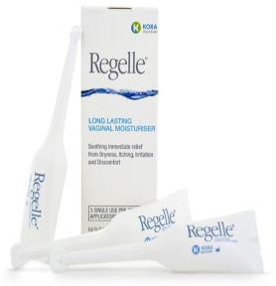
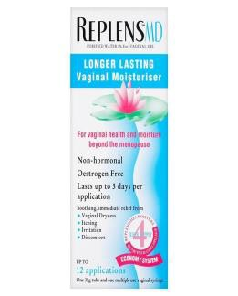
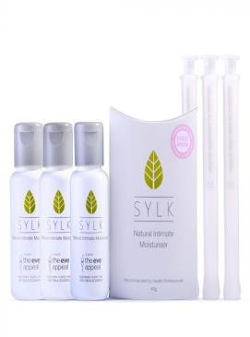
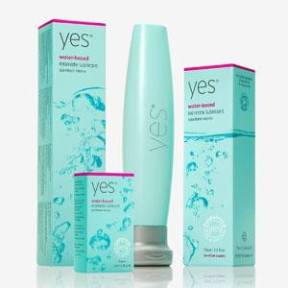
Medical treatments: Over the Counter (OTC)
Vaginal moisturisers maintain vaginal hydration, Long-term relief of
vaginal dryness, decrease pH to premenopausal levels but do not improve epithelium (try Replens, Regelle, Multi-gyn, Yes, etc.)
Vaginal lubricants provide a temporary moistened vaginal epithelium. May be water, silicone or oil based (KY, Sylk, Yes, etc. etc.) Herbal remedies (soy, black cohosh, etc) not effective over placebo acc to 2008 ‘HALT’ study

Slide 58



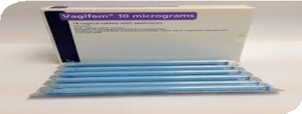

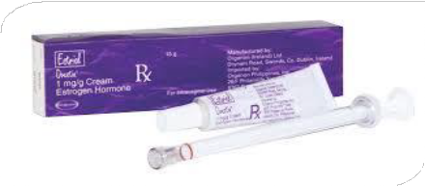
Medical Treatment Options: LVE
Local vaginal estrogen (LVE) in the form of ESTRIOL (E3) (Imvaggis, Ovestin) OR Estradiol (E2) will thicken the epithelium, decrease dryness, return vaginal pH to normal and improve microflora with fewer UTI and decreased OAB symptoms
Adherence issues; studies suggest just 50- 70% take as recommended!
4- 6 months to see full results - so perseverance
Dosing in MIMS is inaccurate
New Blissel will be available soon

Slide 59

Genito Urinary Syndrome after Breast Cancer
Very common side effect of the cancer therapy
Vaginal estrogen Generally regarded as safe regardless of receptor status
Concerns about patients on AI’s thanks to a small, badly controlled 2006 study
BMS suggests offering non-E remedies first and then local vaginal estrogen if oncology do not have an objection

Slide 60
What about Local Vaginal Estrogen for people on Adjuvant Therapies?
LVE can be considered in women who have estrogen negative tumours or who are taking tamoxifen, it should be discussed with the relevant oncology team
LVE should not be used in women taking aromatase inhibitors.
Ospemifene is licensed for use in women who have completed their breast cancer therapy. But there is limited long-term safety data from clinical trials so it is best to inform the breast specialist team in advance.
Due to a lack of long-term data, NICE recommends laser therapy should only be used in the context of a
clinical trial
Vaginal DHEA (“IntraRosa”) acts locally and seems to be effective even when used with tamoxifen and
aromatase inhibitors.
Systemic absorption is meant to be minimal, but clinical trial evidence about the safety and efficacy of
DHEA is required in women treated for breast cancer
The American Society of Clinical Oncology Clinical Practice Guidelines states that DHEA can be offered to women with current or a history of breast cancer who have not responded to other treatments !

Slide 61
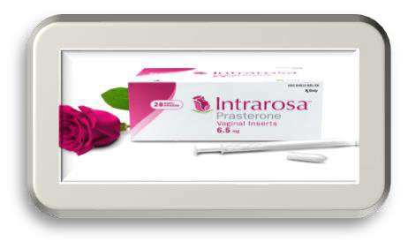
DHEA {de hydro epi-androsterone)- a vaginal cream –Prasterone (“IntraRosa”)
Aromatisation of androstenedione and testosterone locally to estrone (E1) and estradiol (E2)
Works mainly intra cellularly and so virtually NO systemic exposure
Vaginal inserts 6.5mg (0.5% formulation)
May be preferred in breast CA women but no guidelines as yet and still not recommended
Common reactions / side-effects: Vaginal discharge

Slide 62


Ospemifene: a pill you swallow for your vagina
Selective Estrogen Receptor Modulator known as Ospemifene is an oral selective oestrogen receptor
modulator (SERM).
It acts as an oestrogen agonist in the vaginal mucosa, lowering the vaginal pH and improving sx such as vaginal dryness and dyspareunia. It acts as an oestrogen antagonist on the endometrium and breast tissue. It may precipitate or worsen VMS.
A 60 mg daily dose is available on prescription and holds a European license under the name ‘Senshio’.
It is available on order in the ROI but not covered by the medical card or DPS.
Some sources say Ospemifene may be used in women with a history of breast and endometrial cancer who have completed treatment (there is no clinical trial data for patients with current breast cancer). It is not yet licensed for this use in Ireland.
The 2019 BMS consensus statement on use of MHT in women diagnosed with breast cancer stated:
“Ospemifene should not be prescribed to women with a history of breast cancer.”

Slide 63
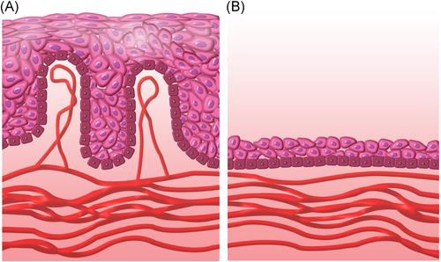
Non-medical treatments for GSM
Sexual activity
Vibrators, dilators
LASER rejuvenation (Mona Lisa, Fotona)

Slide 64
Resources
www.primarycarewomenshealthforum.org
www.thebms.uk
www.womens-health-concern.org
www.menopausematters.co.uk
www.patientinfolibrary.royalmarsden.nhs.uk/brca1brac2

Slide 65
Thank you!
ARC Cancer Support Centres is a registered charity, charity registration number 20028428. 65 Eccles Street, Dublin 7. 01 2150250 info@arccancersupport.ie arccancersupport.ie

