Slide 1
Empower: Menopause & Cancer Survivorship Programme
Session 7: Integration Session

Slide 2

AIM
Aim of Programme was…
To help women manage the impact of disruptive menopause following or alongside cancer treatment and/or surgery
To provide peer support
Briefly recap the programme topics
Consider the learning and take aways
…and say goodbye
Aim of Today is …

Slide 3
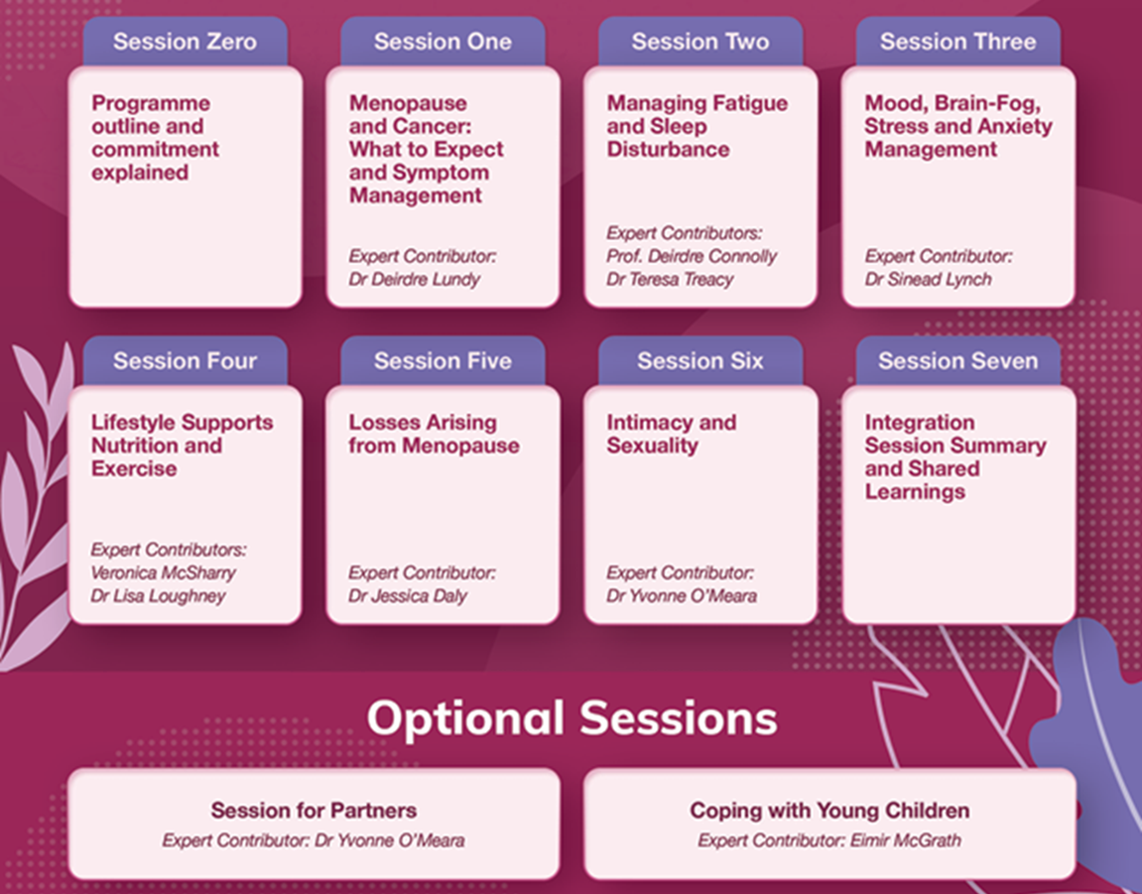
PROGRAMME OUTLINE
Here is a reminder of each of the topics we have covered:
We will now recap briefly each topic to refresh your memory..

Slide 4
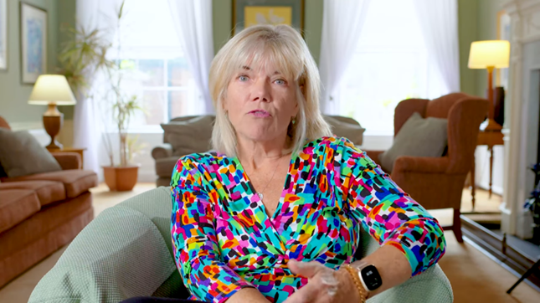
SESSION ONE
What to Expect & Symptom Management
by Dr Deirdre Lundy
Explained:
How cancer treatment can cause menopause-like symptoms
The physical and psychological symptoms of menopause
What the medical profession know so far with regards to treatment
What can be done to manage the symptoms of disruptive menopause

Slide 5
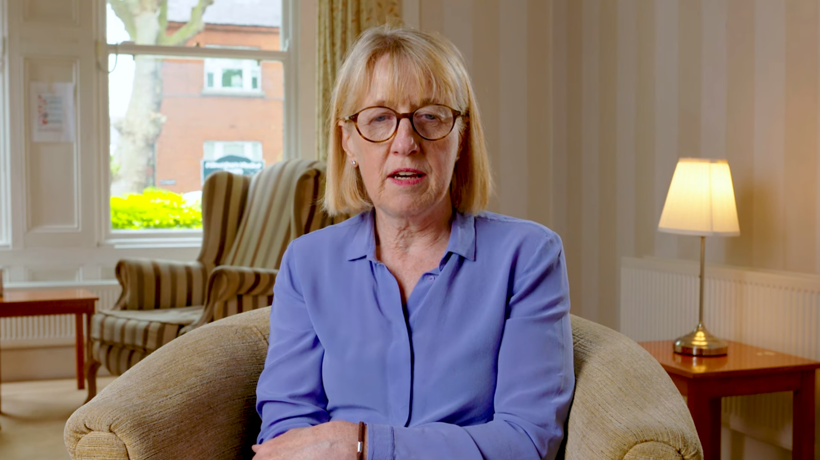
SESSION TWO – PART A
Managing Fatigue
Prof Deirdre Connolly, Occupational Therapist
Explained:
What cancer-related fatigue is and how it is caused
How cancer-related fatigue impacts on daily activities
Strategies to manage cancer-related fatigue
The importance of physical activity in managing cancer-related fatigue
Tips to manage stress

Slide 6
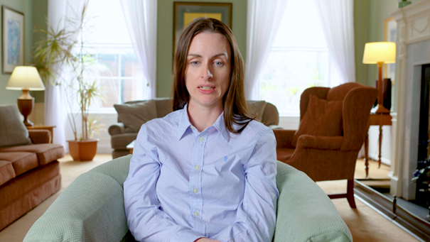
SESSION TWO – PART B
Sleep Disturbance
Dr Teresa Treacy, Clinical Research Fellow with UCD
Explained:
How menopause & cancer contribute to sleep disturbance and insomnia
What can be done to improve sleep

Slide 7
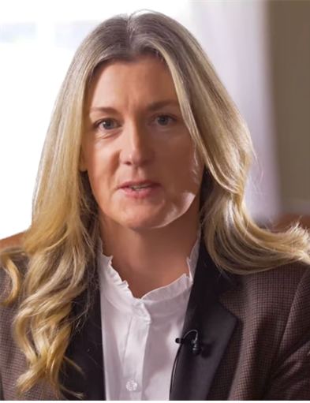
SESSION THREE
Mood, Brain-Fog, Anxiety & Stress Management
by Dr Sinead Lynch, Counselling Psychologist
Explained:
How to cope with low mood, brain-fog, anxiety and stress
What compassion is and why we need to be compassionate towards ourselves
How negative self-talk triggers the threat response
The importance of breathwork
How to manage difficult emotions

Slide 8
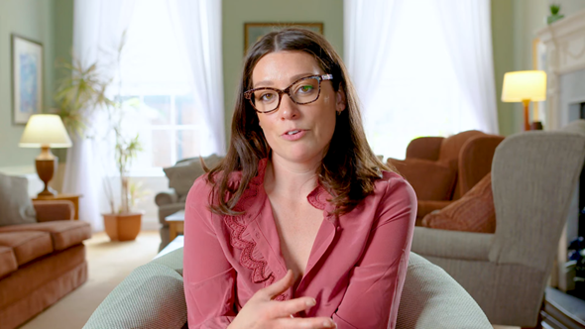
SESSION FOUR – Lifestyle Supports - Part A
Nuitrition
by Veronica McSharry, Oncology Dietician
Explained:
The symptoms of menopause and the evidence behind minimising symptoms through diet
The chronic medical conditions that are associated with menopause
How to optimise diet to promote good health
Practical tips on how to implement dietary changes

Slide 9

SESSION FOUR – Lifestyle Supports - Part B
Exercise
by Dr Lisa Loughney, Clinical Exercise Physiologist
Explained:
The important role exercise plays in the cancer treatment pathway
How exercise can reduce some of the side effects of cancer and improve quality of life
Tips on how to get involved in exercise
The community-based exercise programme: Exwell Medical (exwell.ie).

Slide 10
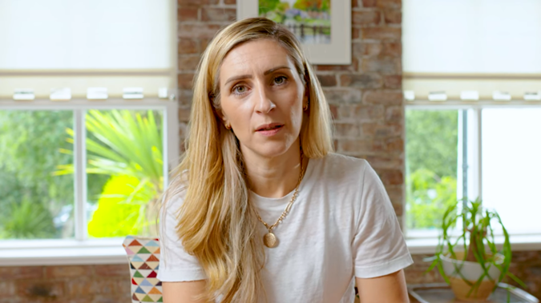
SESSION FIVE
Losses Arising from Menopause & Cancer
by Dr Jessica Dailey, Counselling Psychologist
Explained:
The losses arising from menopause and cancer: physical changes, loss of fertility, loss of a sense of self, loss of youthfulness, etc.
How to reframe some of these losses and be more compassionate towards self
Some of the difficulties of cancer-related menopause: Increased distress, fertility concerns, sexual changes.
How we can understand ourselves and what can help – finding meaning, sharing stories, reconnecting with self (journalling, ritual)

Slide 11
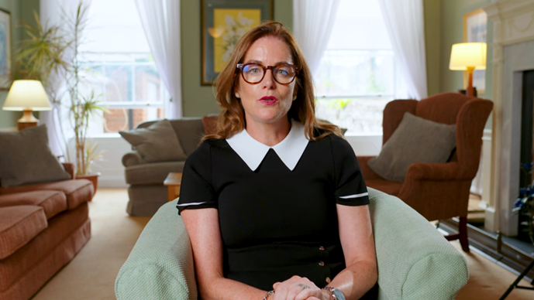
SESSION SIX
Sexuality & Intimacy
by Dr Yvonne O’Meara, Systemic Psychotherapist & Psychosocial Oncologist
Explained/Invited Us:
The prevalence of sexual problems in society
To think about our relationship with our bodies, and with sexuality & intimacy
The Sexual Response Cycle and low desire.
Solutions and ways to approach these issues - how to integrate intimacy into ones life/relationship

Slide 12

PORTAL
Reminder:
All the video presentations and slides along with many other resources are available on the Empower Programme Portal.

Slide 13

SUPPORTS AVAILABLE
Finally, please remember also…
..while the Empower Programme is closing today, you can continue to connect with us through the various supports available in our centre.

Slide 14
Thank you

