Slide 1
Empower: Menopause & Cancer Survivorship Programme Overview
Session Zero - Introduction

Slide 2

AIM OF TODAY
Introduce the Empower Programme
Outline the commitment involved
Answer any questions
Get to know each other

Slide 3



BACKGROUND
In 2022 ARC Cancer Support Centres, in partnership with UCD School of Medicine and sponsored by the National Cancer Control Programme (NCCP), developed the Empower Programme to bridge the information gap in Ireland for women impacted by menopause resulting from cancer treatment.
This new programme, the first of its kind, was evaluated in terms of effectiveness by a research team at UCD School of Medicine, led by Professor Donal Brennan.
The Programme was developed in response to insights provided by women going through similar experiences. Feedback and data gathered from women who participated in this research was used to refine the programme, to further help others experiencing something similar.
Following the successful development of the Programme by ARC the NCCP expanded the programme to other Cancer Support Centres throughout Ireland.

Slide 4
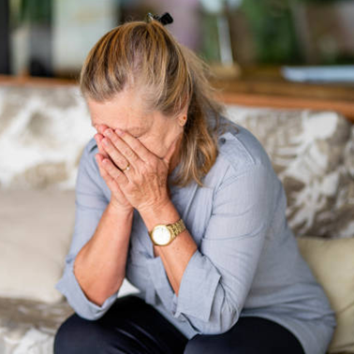

AIM OF THE PROGRAMME
The aim of the Empower Programme is:
To deliver a supportive programme to help women self-manage impact of Menopause following or alongside cancer treatment.
Provide peer support to reduce isolation.
And to provide a portal for access to resources in your own time.

Slide 5

THE PEER SUPPORT ELEMENT
The Empower Programme provides you with peer support. Giving you an opportunity to connect with others experiencing something similar.
You all have had or currently have cancer. You have experienced symptoms of menopause as a direct result of cancer treatment or surgery. You all have this in common.
Everyone’s journey is important. Yours is not insignificant compared to another’s.
If anything comes up for you during the course that you do not wish to raise in the peer support element, please contact us afterwards.

Slide 6

Programme Overview
This is an overview of each of the sessions provided:
The Programme is comprised of 8 sessions
Online sessions are 2h30 minutes long with a 20 minute break
In-person sessions are 2 hours long with a 5 minute break

Slide 7

PROGRAMME FORMAT
Session Zero is today’s session and we may finish earlier if all questions and introductions are complete.
Sessions one to six are the expert sessions. During each of these sessions you will watch either 1 or 2 video presentations, depending on the topic. This will be followed by the peer support element where we will have time to discuss what you have learnt and share with each other what you are experiencing.
Session Seven (week 8) will be our Integration Session. In this session we will briefly recap each of the expert presentation sessions and consider the learnings and takeaways of the Empower Programme.

Slide 8

OPTIONAL SESSIONS
The Empower Programme includes two optional sessions as follows:
Partner’s Session:
A Video presentation by
Dr Yvonne O’Meara, Systemic Psychotherapist & Psychosocial Oncologist.
This online session is provided to support your partners who are recognised as the silent patient. It is understood that the physical effects and psychological symptoms of cancer and menopause that you experience also impacts your partner and, as a consequence, your relationship.
Some partners may need some encouragement to attend but those who do attend find it very beneficial.
If your partner would like to attend, please email our centre with a copy to your partner and include your partner’s contact number.

Slide 9
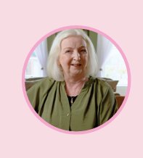
OPTIONAL SESSIONS
Coping with Young Children
A video presentation by
Dr Emir McGrath, Psychotherapist and Play Therapist.
Coping with Young Children is provided as an optional session for those participants who are parenting young children.
This video will be available to watch at the end of the programme via the portal in your own time however if you would like to attend a live session facilitated by a Play Therapist please let us know and we will provide you with more details.

Slide 10
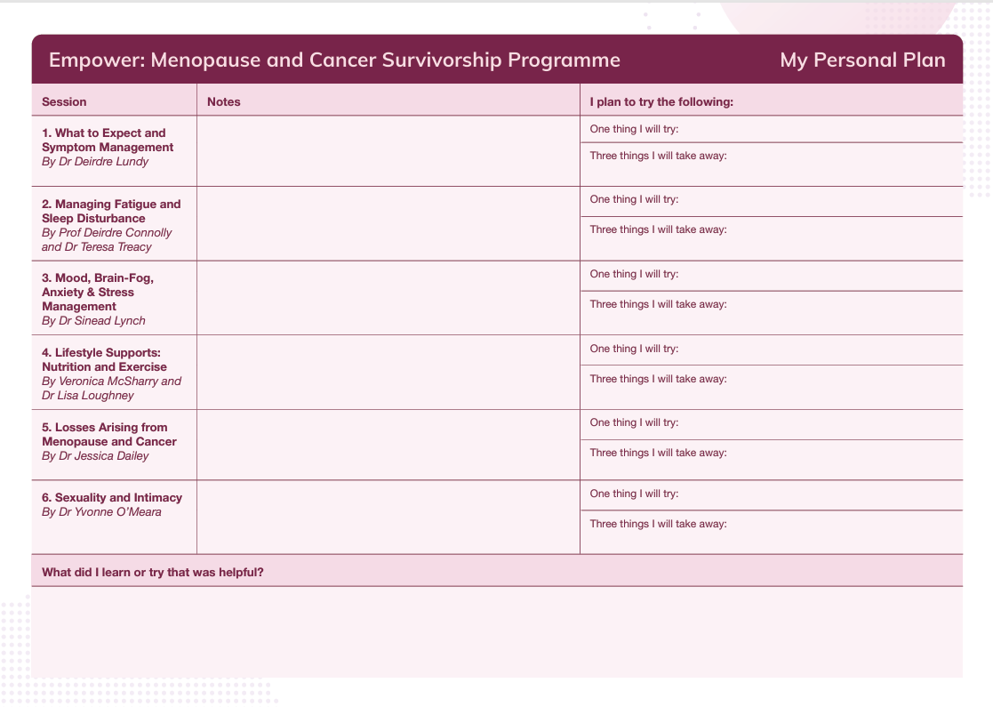

MY PERSONAL PLAN
We encourage you to use your ‘My Personal Plan’ to take note of anything you learn that you might like to try throughout the programme.

Slide 11

HOUSEKEEPING - In Person
Please ensure your phones are on silent or turned off
If you need to leave early or arrive late due to appointments that’s fine, but we cannot repeat content due to tight time for each session
Please arrive on time, to enable a smooth introduction to the session.
Break time is 20-minutes, and we ask you return promptly.

Slide 12
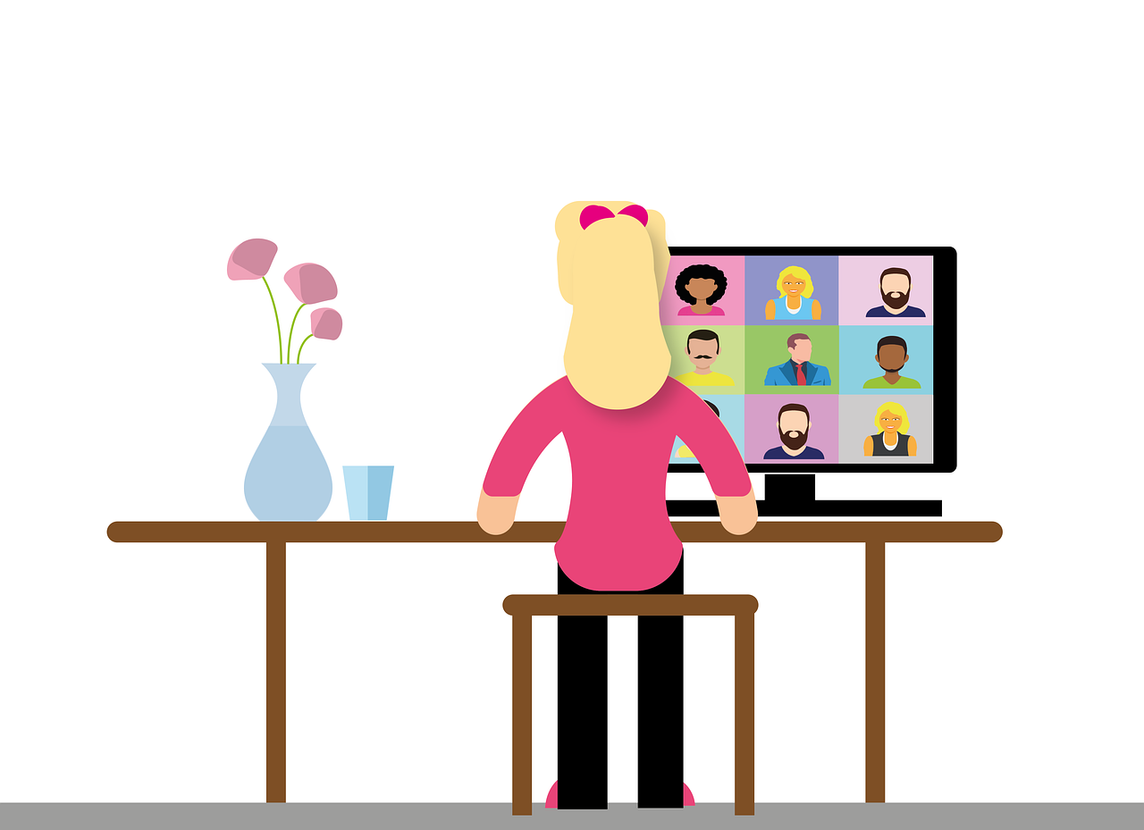
HOUSE KEEPING - Online
Please have your own (full) name on screen
Please ensure you are on mute during the video
Please have your camera on during the peer support element/group discussion as this helps us to connect with each other.
Please ensure your phone is on silent or turned off
If you need to leave early or arrive late due to appointments that’s fine, but we cannot repeat content due to tight time for each session
Please arrive on time, to enable a smooth introduction to the session.

Slide 13

PORTAL
Following each session, you will be given access to each of the videos and presentation slides along with many other resources which you can access in you own time via a portal.
Each new session is accessed via a unique link that will be sent to you each week. The password will remain the same throughout.
This step-by-step release allows you to focus on one session at a time while building on previous knowledge.
Please bookmark or save the link each time, as it will include access to all previously unlocked sessions

Slide 14

CODE OF CONDUCT
The peer support element aims to provide an open and safe environment, where you can come together to join in group discussions following each of the weekly sessions.
It is a place for you to share experiences, feelings, and knowledge with the confidence that everything said is confidential.
A Code of conduct is provided and it is important that we respect and protect the safety, privacy, confidentiality, and the comfort of other participants, where personal stories may be shared.
If you haven’t already done so, please return the Code of Conduct indicating your agreement.
For online participants only:
        Please ensure you are in a private room or use a headset so that other participants will not be overheard by others in your environment.
        Sessions will not be recorded and we ask you do not record also.

Slide 15

CODE OF CONDUCT
Please do not discuss any details shared within the group outside the group in any way that would identify another individual.
You may not always agree with each other however, please remember that each person’s experience is equally valid.
Take care of yourselves: You are welcome and encouraged to share your personal journeys however please do not make any big disclosures.
However, please know that we have supports available for you outside of the group if you would like to avail of them.

Slide 16

SUPPORTS AVAILABLE
If you feel triggered after a session and would like some additional support or a follow up call from myself as facilitator, please do not hesitate to contact our centre.

Slide 17
Thank you

